Slide 1
Decision trees

Slide 2
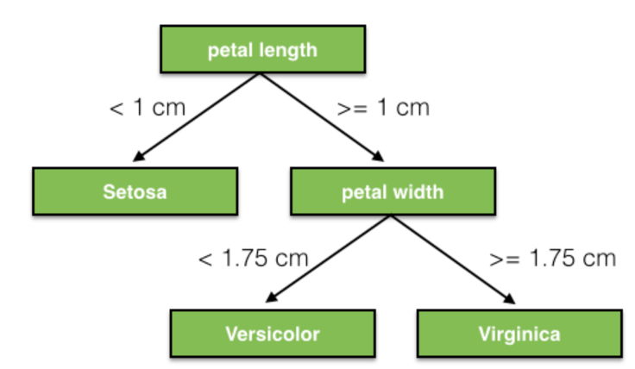
Decision trees
Decision Trees are a type of Supervised Machine Learning (that is you explain what the input is and what the corresponding output is in the training data) where the data is continuously split according to a certain parameter. The tree can be explained by two entities, namely decision nodes and leaves. The leaves are the decisions or the final outcomes. And the decision nodes are where the data is split.

Slide 3
How does the Decision Tree algorithm work?
Select the best attribute using Attribute Selection Measures(ASM) to split the records.
Make that attribute a decision node and breaks the dataset into smaller subsets.
Starts tree building by repeating this process recursively for each child until one of the condition will match:
All the tuples belong to the same attribute value.
There are no more remaining attributes.
Notes:
https://www.datacamp.com/community/tutorials/decision-tree-classification-python

Slide 4
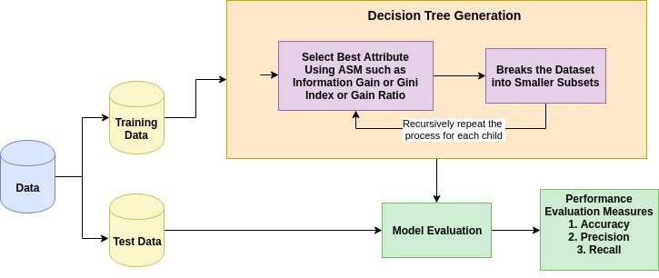
Decision Trees

Slide 5
Attribute Selection Measures
Attribute selection measure is a heuristic for selecting the splitting criterion that partition data into the best possible manner. It is also known as splitting rules because it helps us to determine breakpoints for tuples on a given node.
ASM provides a rank to each feature(or attribute) by explaining the given dataset.
Best score attribute will be selected as a splitting attribute
In the case of a continuous-valued attribute, split points for branches also need to define.
Most popular selection measures are Information Gain, Gain Ratio, and Gini Index.

Slide 6
Information Gain
Information gain is the decrease in entropy. Information gain computes the difference between entropy before split and average entropy after split of the dataset based on given attribute values.
In physics and mathematics, entropy referred as the randomness or the impurity in the system. In information theory, it refers to the impurity in a group of data.
Notes:
https://www.datacamp.com/community/tutorials/decision-tree-classification-python

Slide 7
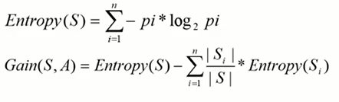

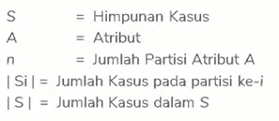
Information Gain
to select the root attribute, based on the Highest Gain value of the existing attribute.
to get the gain value we have to calculate the entropy.
ID3 (Iterative Dichotomiser) decision tree algorithm uses information gain.
Notes:
https://www.youtube.com/watch?v=vpOOzVoblkQ&t=515s

Slide 8
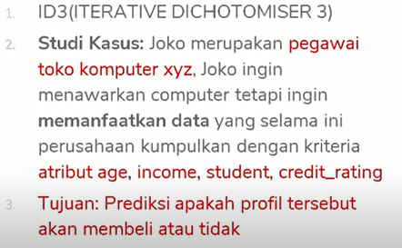
Contoh study kasus

Slide 9
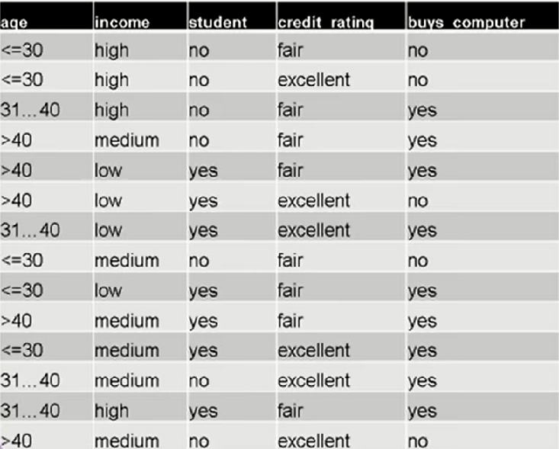
Contoh study kasus

Slide 10
Langkah penyelesaian
Siapkan data yang akan di training.
Pilih atribut yang akan menjadi root. Cara mencarinya yaitu dengan mencari gain tertinggi:
Buat cabang untuk tiap-tiap nilai.
Ulangi proses untuk setiap cabang sampai semua kasus pada cabang memiliki kelas yang sama

Slide 11
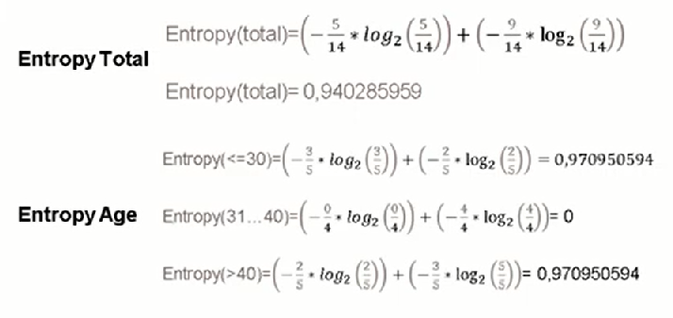
Langkah penyelesaian

Slide 12
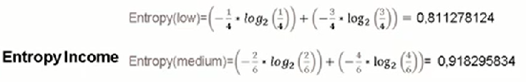
Langkah penyelesaian

Slide 13
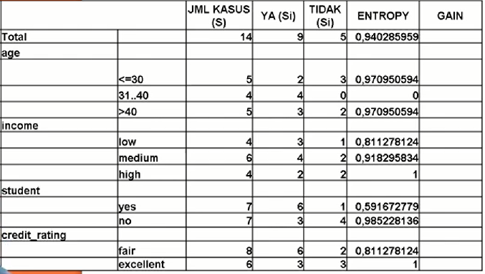
Langkah penyelesaian

Slide 14
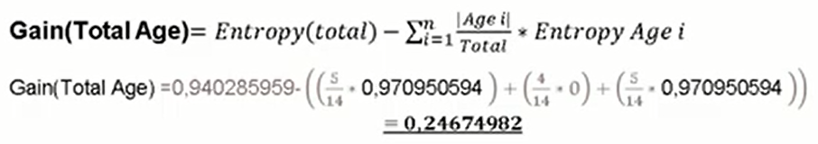
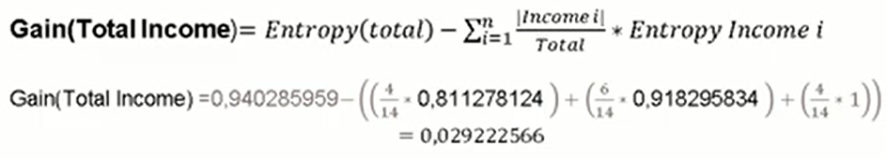

Slide 15
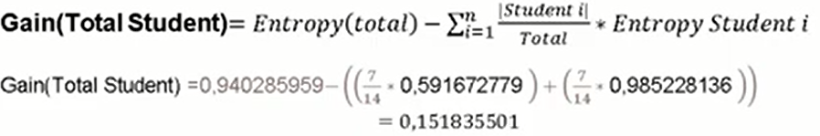

Slide 16

Gain(total Credit_rating) =

Slide 17
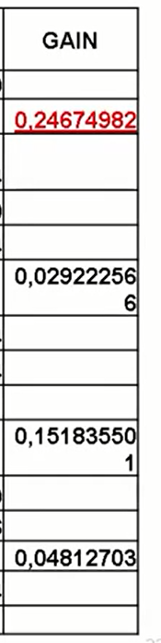
Gain tertinggi (age)

Slide 18
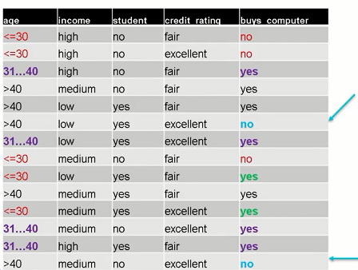
<=30 ada 3 no, 2 yes.
Berarti perlu hitung ulang
31..40 ada 4 yes.
Berarti tidak perlu hitung ulang.
>40 ada 3 yes, 2 no.
Berarti perlu hitung ulang.

Slide 19
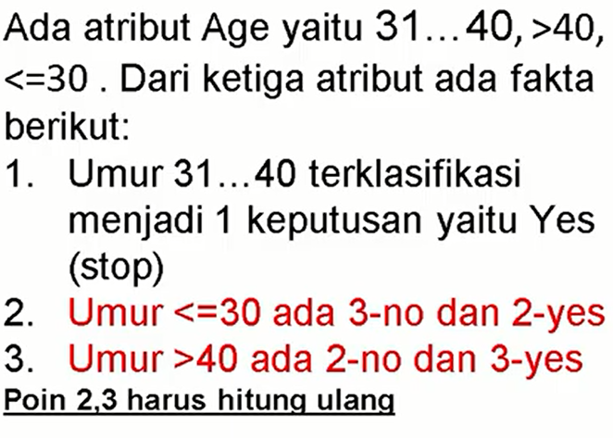
s
Age
<=30
>40
31...40
1.1
???
YES
1.3
???

Slide 20
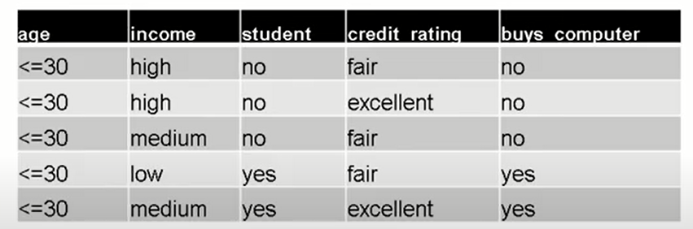
Filter factor age < = 30 untuk node 1.1

Slide 21
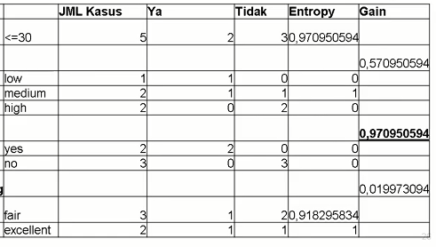
Dari hasil hitungan didapatkan yang student dengan nilai 0.97.
age
income
stundent
Credit_rating

Slide 22
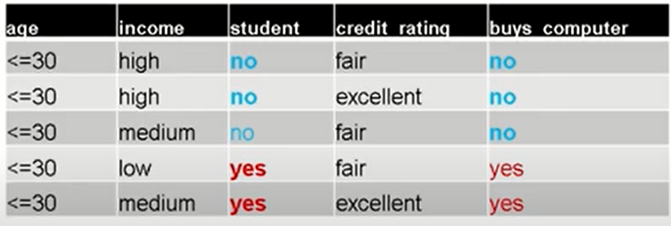
Filter age <= 30 dan student
Dari data dapat dilihat tidak ada yg dual (yes dan no). Karena ketika student no , buy_computernya juga no. ketika student yes, buy_computernya juga yes

Slide 23
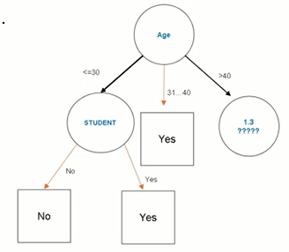
hasilnya

Slide 24
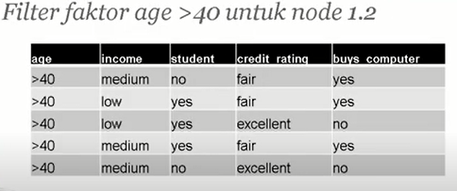
Filter factor age > 40 untuk node 1.1
Setelah kita lihat kemudian hitung lagi entropy kemudian gain

Slide 25
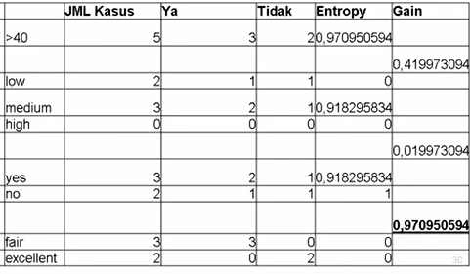

Slide 26
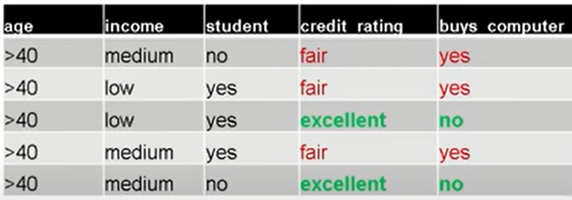
Filter age <= 30 dan credit_rating

Slide 27
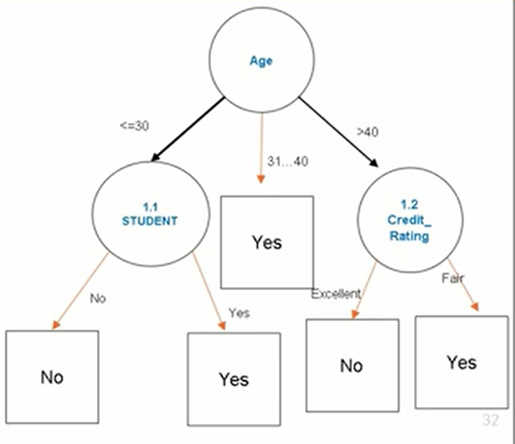

Slide 28
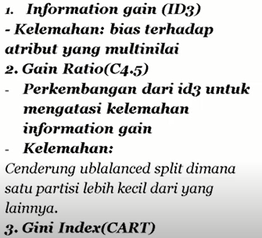
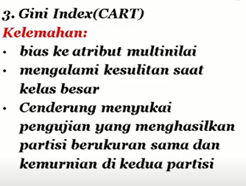
Perbandingan dalam pemilihan atribut

Slide 29
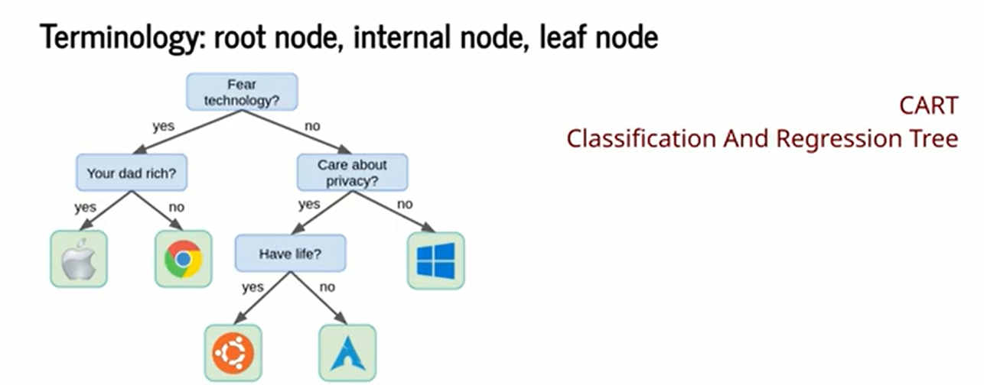
Algoritma cart
Notes:
https://www.youtube.com/watch?v=l9I9v2sWFhQ&t=20s
https://www.youtube.com/watch?v=5wwXKtLkyqs&t=1298s

Slide 30
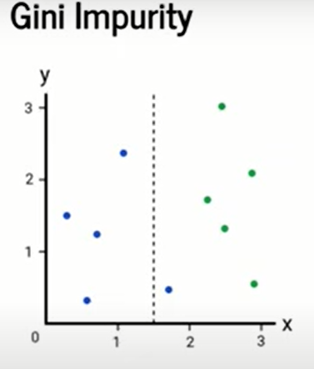
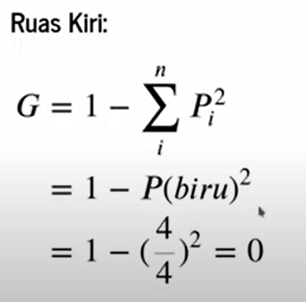
gini
Gini impurity menggunakan nilai antara 0 (murni) dan 1(paling tidak murni). Contoh ada 10 data poin terbagi dari 2 class. Class biru dan hijau.
Keterangan:
4 yg diatas adalah jumlah kelas biru.
4 yg dibawah total keseluruhan data dikiri.
Hasil dari G= 0 (kemurnian sempurna), karena mruni warna semuanya biru

Slide 31
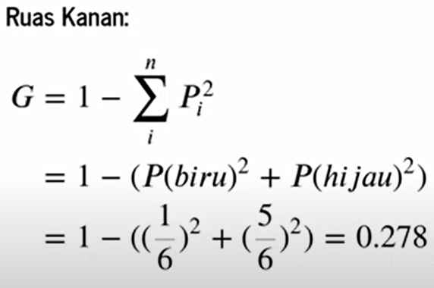

22
= 0.1668

Slide 32
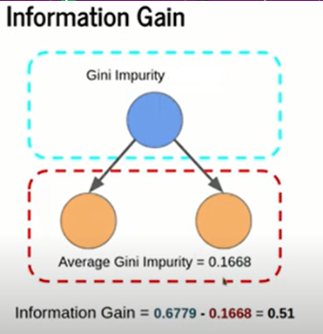
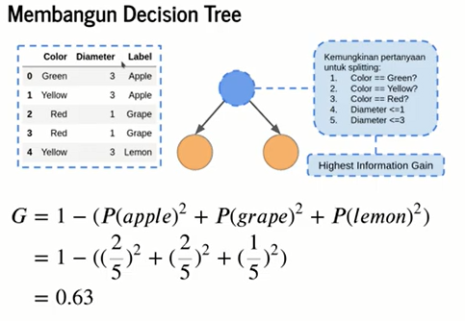
Notes:
Yang atas sebelum splitting. Data akan terus split sampai gini impurity = 0 atau sampai batasan yg tentukan

